Slide 1

Lists in CSS
BCAC 0016 FUNDAMENTALS OF INTERNET PROGRAMMING
Module 2
Dr. Kanta Prasad Sharma
Assistant Professor,
CEA, GLA University, Mathura

Slide 2
Outline
CSS Lists
Unordered Lists
Ordered Lists
BCAC0016: Fundamentals of Internet Programming

Slide 3
CSS Lists
The CSS list properties allow you to:
Set different list item markers for ordered lists
Set different list item markers for unordered lists
Set an image as the list item marker
Add background colors to lists and list items
BCAC0016: Fundamentals of Internet Programming

Slide 4
CSS Lists (Contd.)
Different List Item Markers:
The list-style-type property specifies the type of list item marker.
The following example shows some of the available list item markers:
ul.a { list-style-type: circle; } ul.b { list-style-type: square; }
ol.c { list-style-type: upper-roman; } ol.d { list-style-type: lower-alpha; }
BCAC0016: Fundamentals of Internet Programming

Slide 5
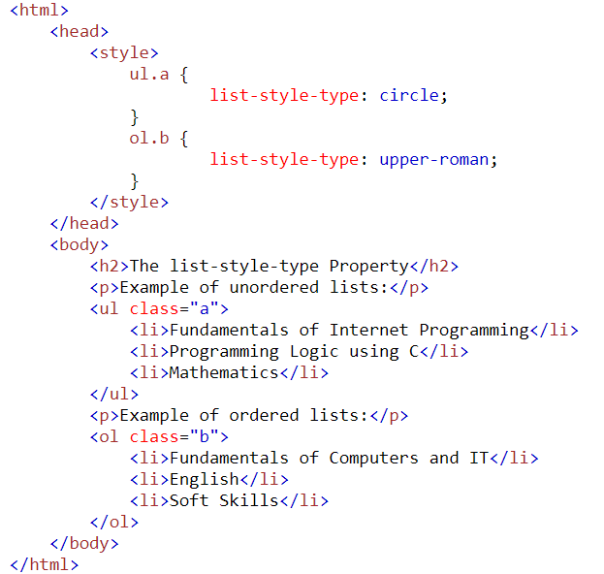
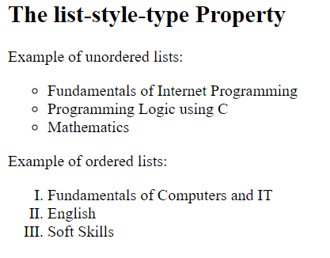
CSS Lists (Contd.)
OUTPUT:
BCAC0016: Fundamentals of Internet Programming

Slide 6
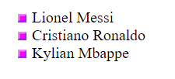
CSS Lists (Contd.)
An Image as The List Item Marker
The list-style-image property specifies an image as the list item marker:
ul { list-style-image: url('sqpurple.gif'); }
<ul>
<li>Lionel Messi</li>
<li>Cristiano Ronaldo</li>
<li>Kylian Mbappe</li>
</ul>
OUTPUT:
BCAC0016: Fundamentals of Internet Programming

Slide 7
CSS Lists (Contd.)
Styling List With Colors:
We can also style lists with colors, to make them look a little more interesting.
Anything added to the <ol> or <ul> tag, affects the entire list, while properties added to the <li> tag will affect the individual list items:
BCAC0016: Fundamentals of Internet Programming

Slide 8
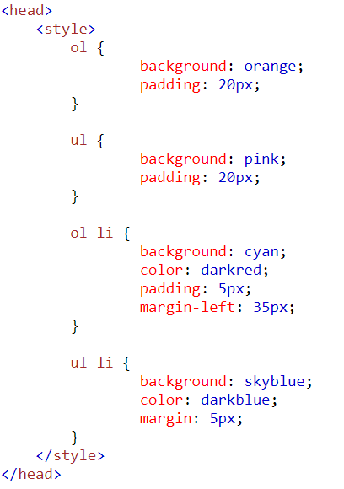
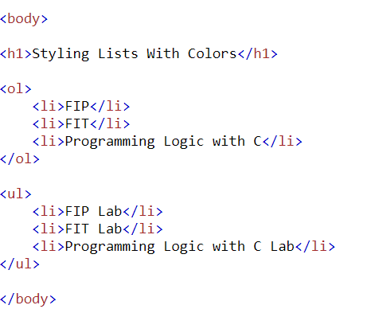
CSS Lists (Contd.)
BCAC0016: Fundamentals of Internet Programming

Slide 9
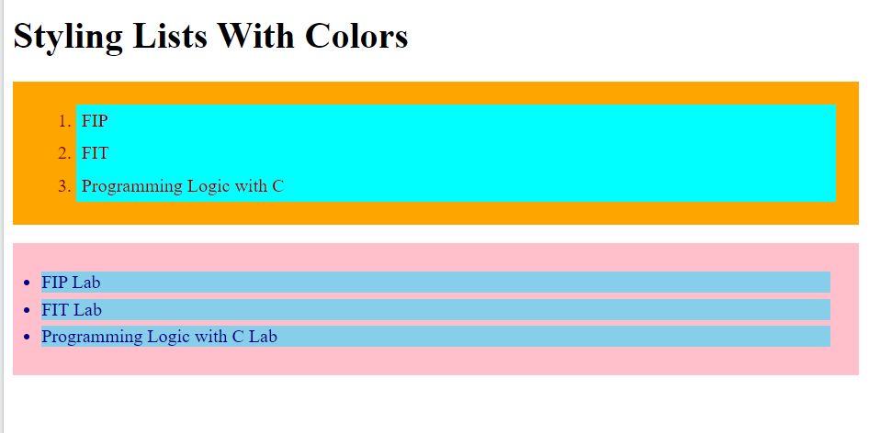
CSS Lists (Contd.)
OUTPUT:
BCAC0016: Fundamentals of Internet Programming

Slide 10
Thank You

